Slide 1
Presentation on
PMT PASS SYSTEM

Slide 2
Project guide and team members
Project guide – Ms.Jyoti Kanse Mam
Team Members :
Samarth Bhosale – 3902
Pushkar Chillal – 3906
Pranav Karwan - 3923

Slide 3
Presentation Overview
Introduction
Problem definition
Need of the system
Scope of the system
Requirement analysis
Screenshots
Limitations
Future Enhancement
Bibliography

Slide 4
Introduction
PMT_Pass is web-based tool which helps people renewing and registering the bus pass online. The Online Bus Pass System is made for to automize the current process of bus pass, the user can get the pass by online instead of go to the bus stop and stand in a queue.
This System is designed by keeping in mind both users and it allows users to register their details with the system, and then it allows user to use this software to the system after logged in successfully.
This is faster way than old system. This site can be accessed throughout the world with proper login provided. This system can be used for newly registration for passes, renewing old passes etc. This system reduces time and provides proper management.

Slide 5
Problem definition
Now days Public transport is increasing. Most of the people like working women, working men, students, preferring to use public transports like bus. So issue passes for bus instead of buying ticket every day, makes easy to travel and saves money.
But to issue passes we have to go in bus depot and we have to stand in queue as well as we have to suffer for validation of our documents.
So, to reduce these efforts this system is designed.

Slide 6
Need of the system
People must go to the bus depot and stand in a queue for getting the pass as well as renew the bus pass. If someone leaving in rural area then he/she have to travel to respective area’s / village’s depot to issue pass. This is so time consuming process, so there is need of new system which reduces unnecessary efforts and make it easy. There is no facility for the online payment.
The current system is manual system in which transport user has to go to the bus depot for getting the pass as well as renew the pass.
The proposed system is design in such a way that overcomes all the problems of current system.

Slide 7
Scope of the proposed system
The proposed system is design in such a way that overcomes all the problems of current system
User can renew the pass by online from their home instead of going physically to the bus depot and stand in a queue.
User can get pass from any depot.
Students can pay the payment by online /offline.

Slide 8
Requirement analysis
Software requirement
Operating System : Windows, Linux or Further
Languages : Java, HTML
Platform : Java
Web Servers : Tomcat Server
Backend : Postgres SQL
Hardware requirement
Processor : Pentium III or Any Advanced Processor
RAM : 256 MB or More
Hard disk : 40 GB or more

Slide 9
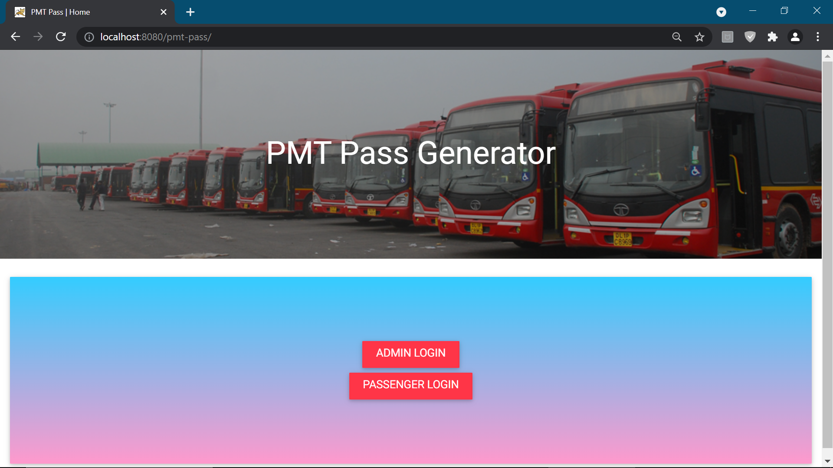

Slide 10
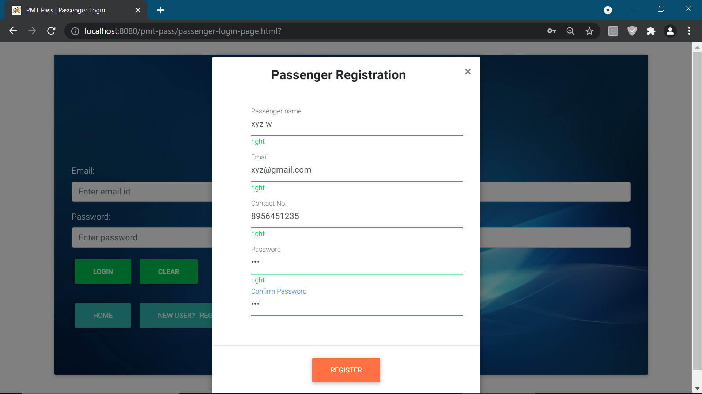

Slide 11
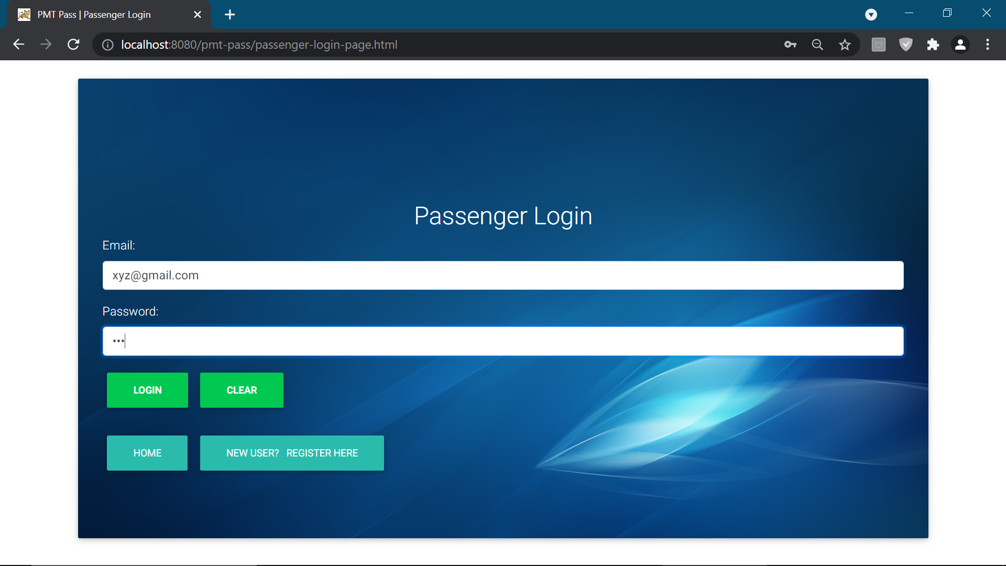

Slide 12
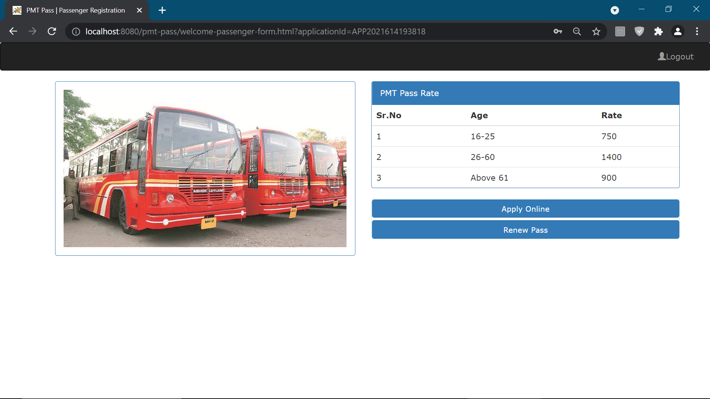
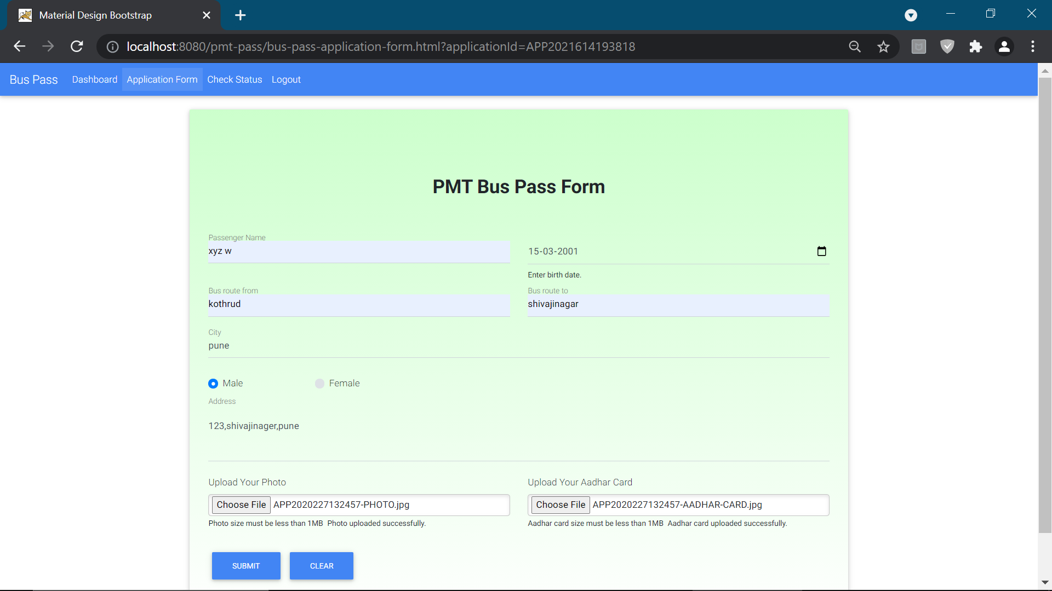

Slide 13
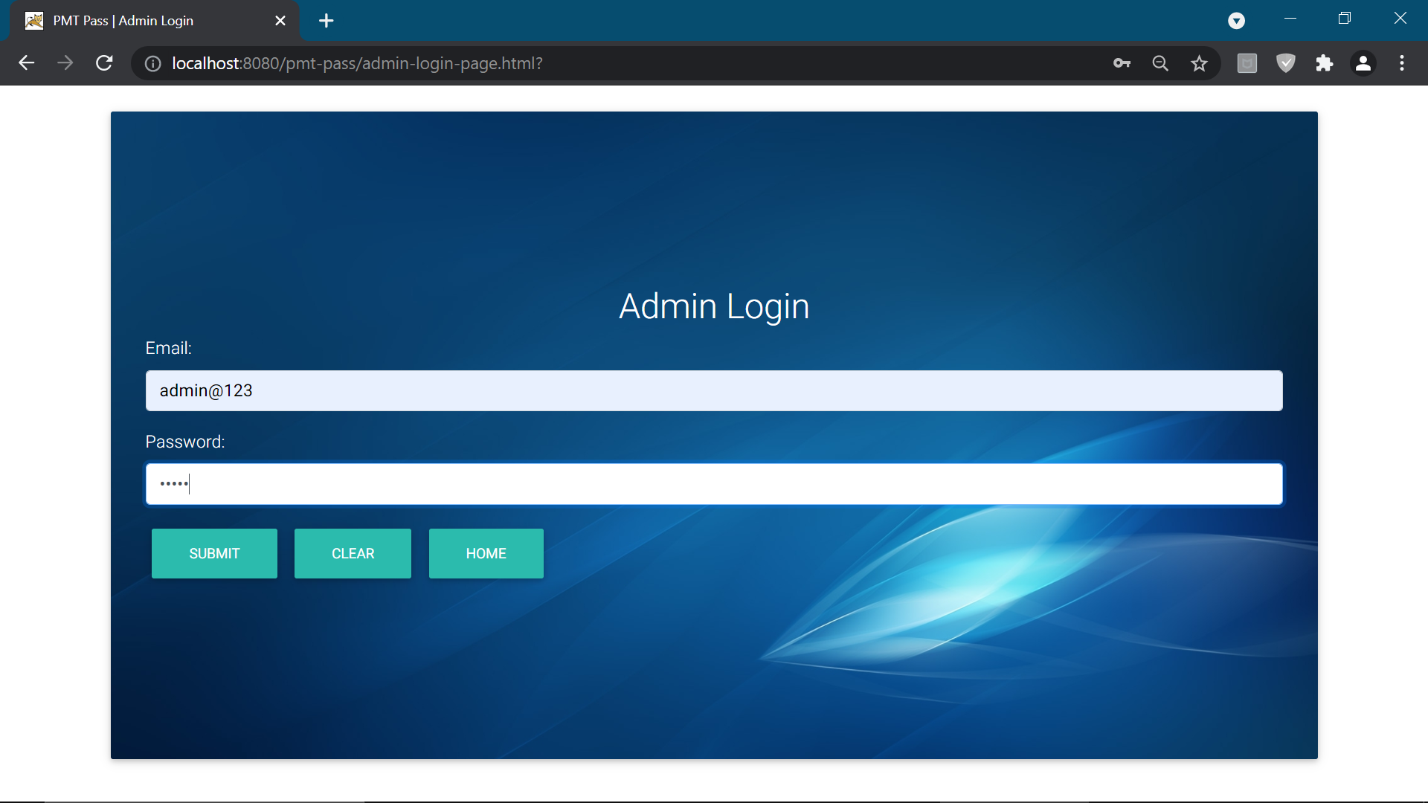

Slide 14
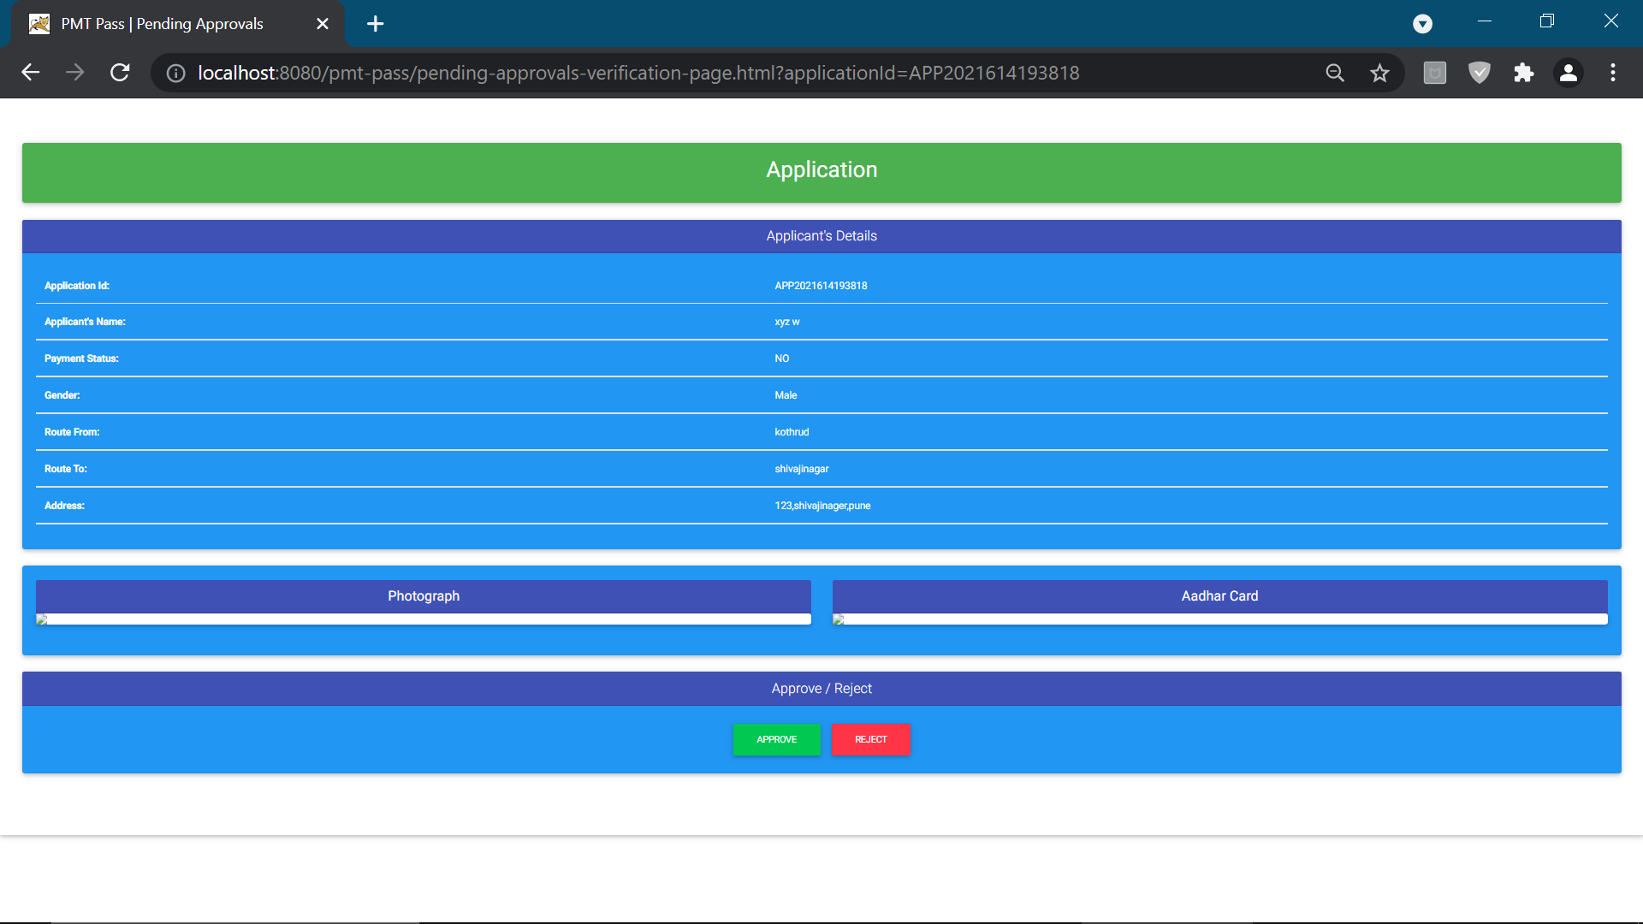

Slide 15
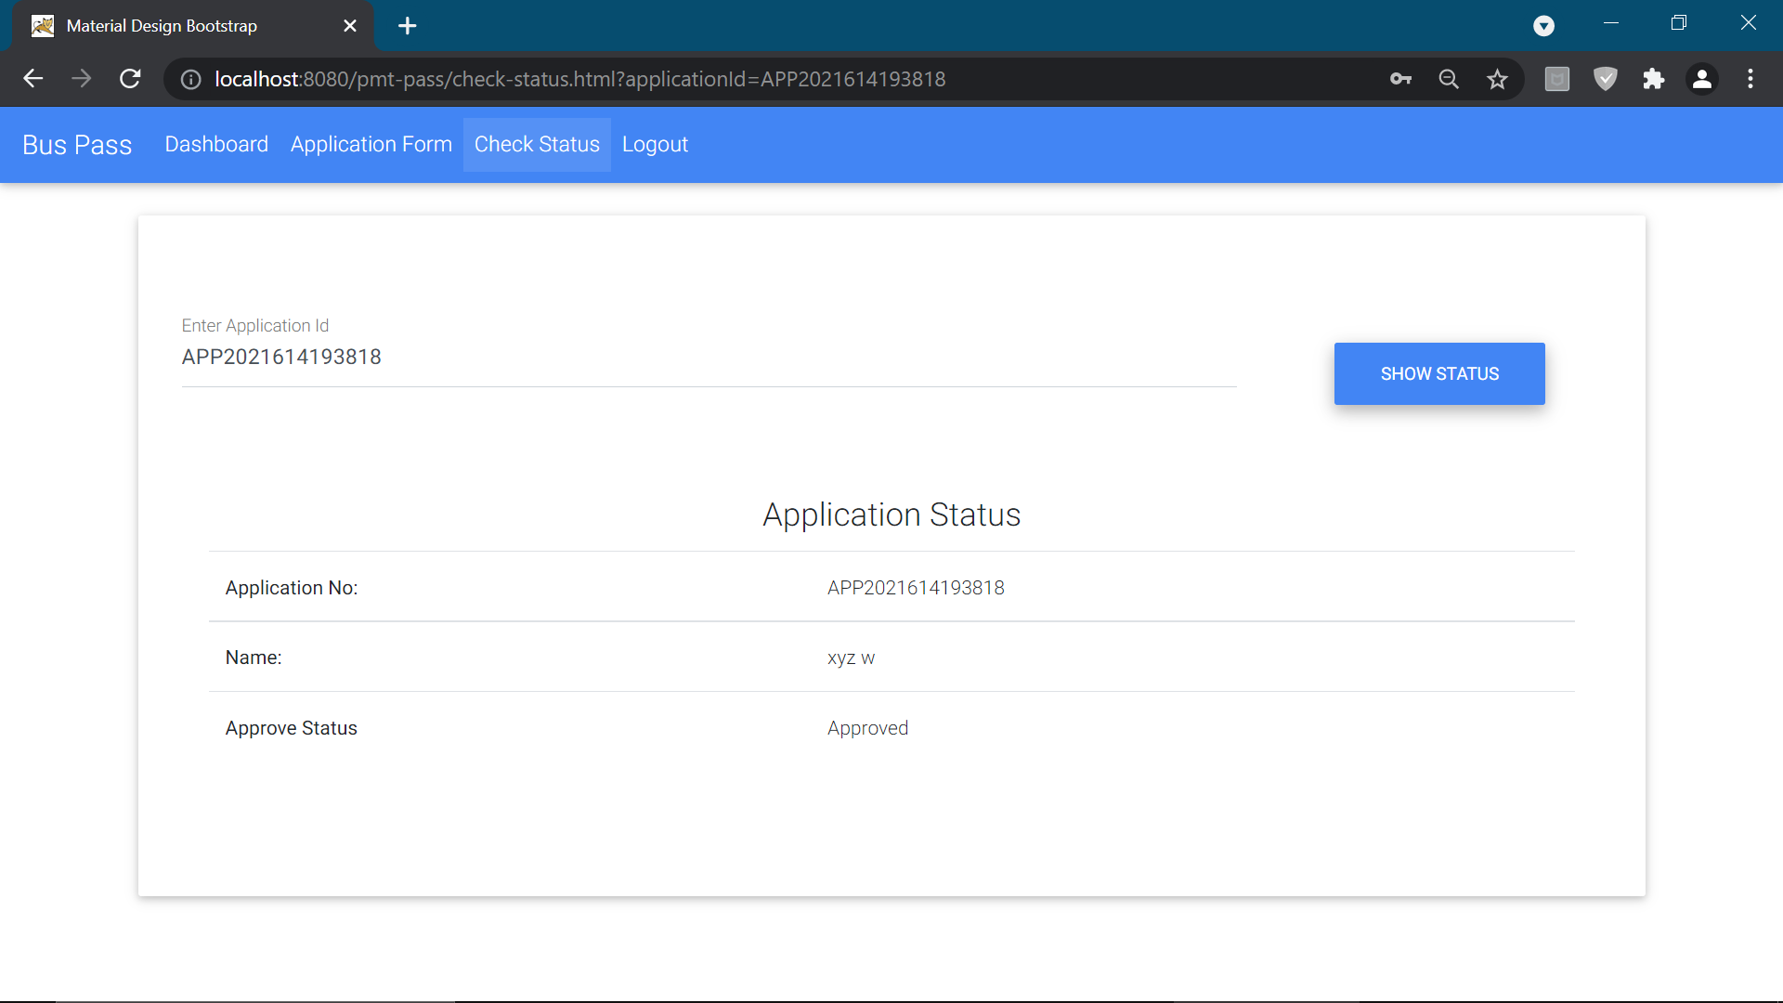

Slide 16
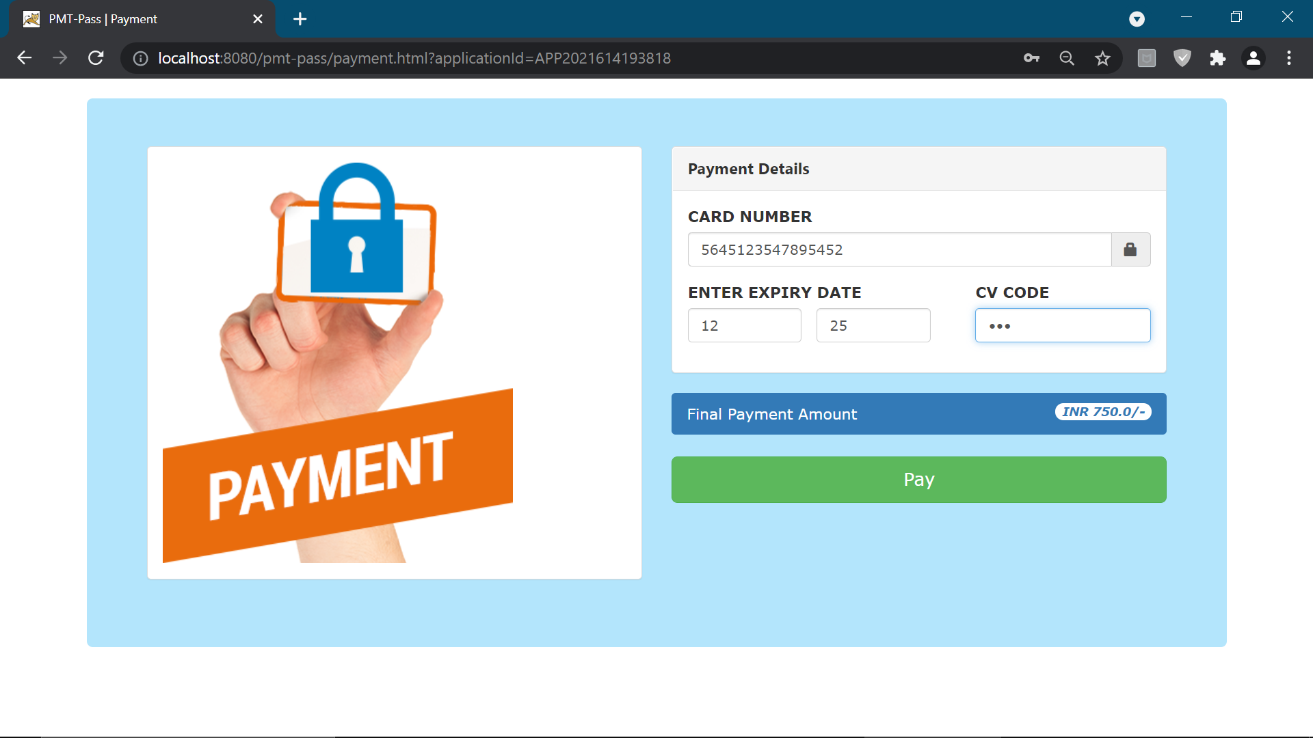

Slide 17
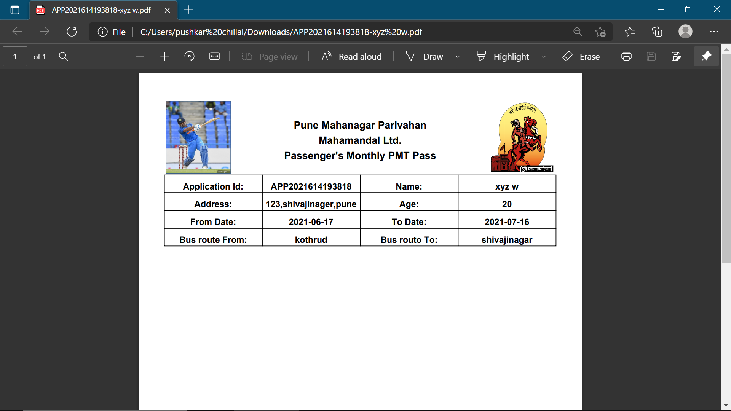

Slide 18
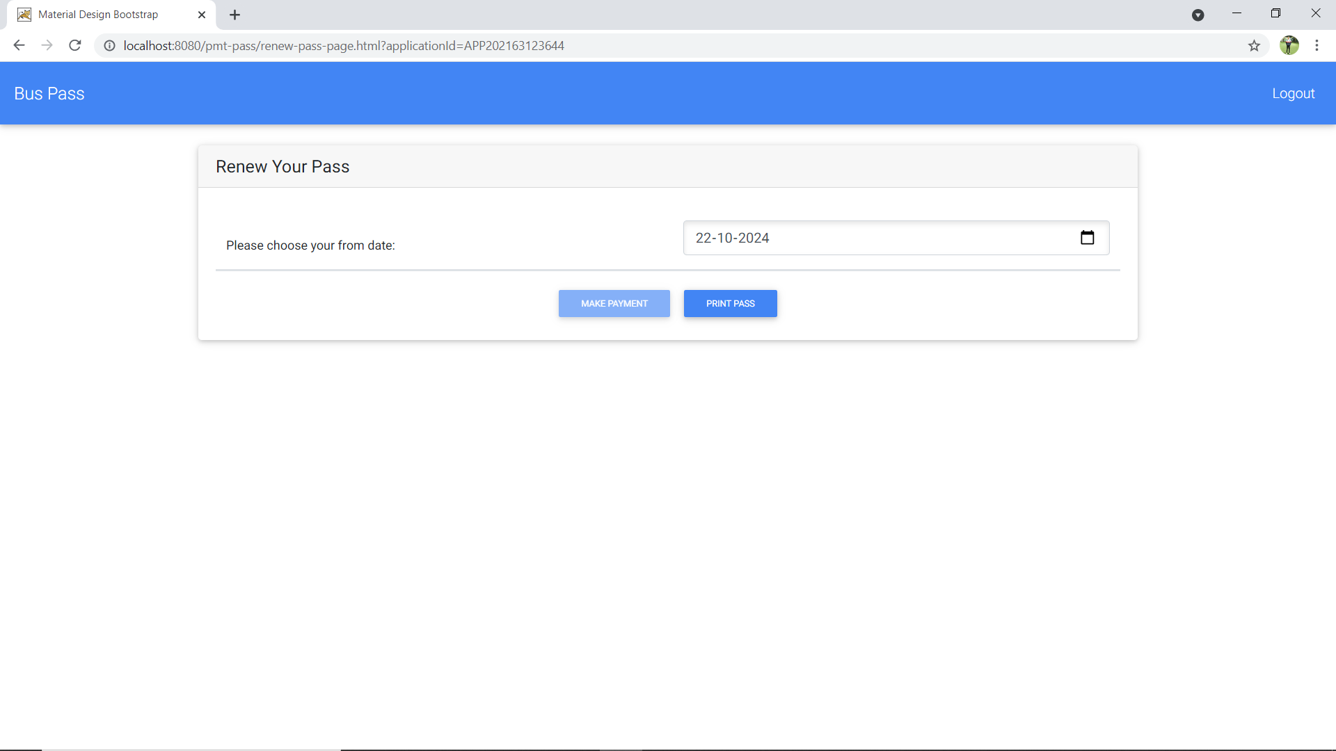

Slide 19
limitations
The size of the database increases day-by-day, increasing the load on the database back up and data maintenance activity.
Training for simple computer operations is necessary for the users working on the system.
Cyber-crimes are increasing day by day, so advance data security is needed to implement.

Slide 20
Future enhancement
This System being web-based and an undertaking of Cyber Security Division, needs to be thoroughly tested to find out any security gaps.
Cyber-crimes are increasing day by day, so advance data security will be implemented in future.
More searching options will be provided to the employer (company) in the future.

Slide 21
bibliography
Software Engineering
HTML & Web Designing
www.google.com
www.youtube.com

Slide 22
Thank you

